Slide 1
Defending the Rule of Law: a shared challenge
Medel’s 40th Anniversary conference

Slide 2
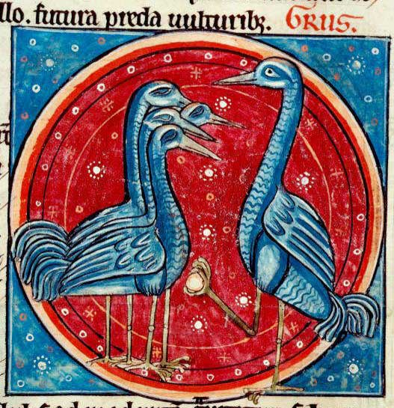

Slide 3
Attentifs ensemble
On our guard together

Slide 4
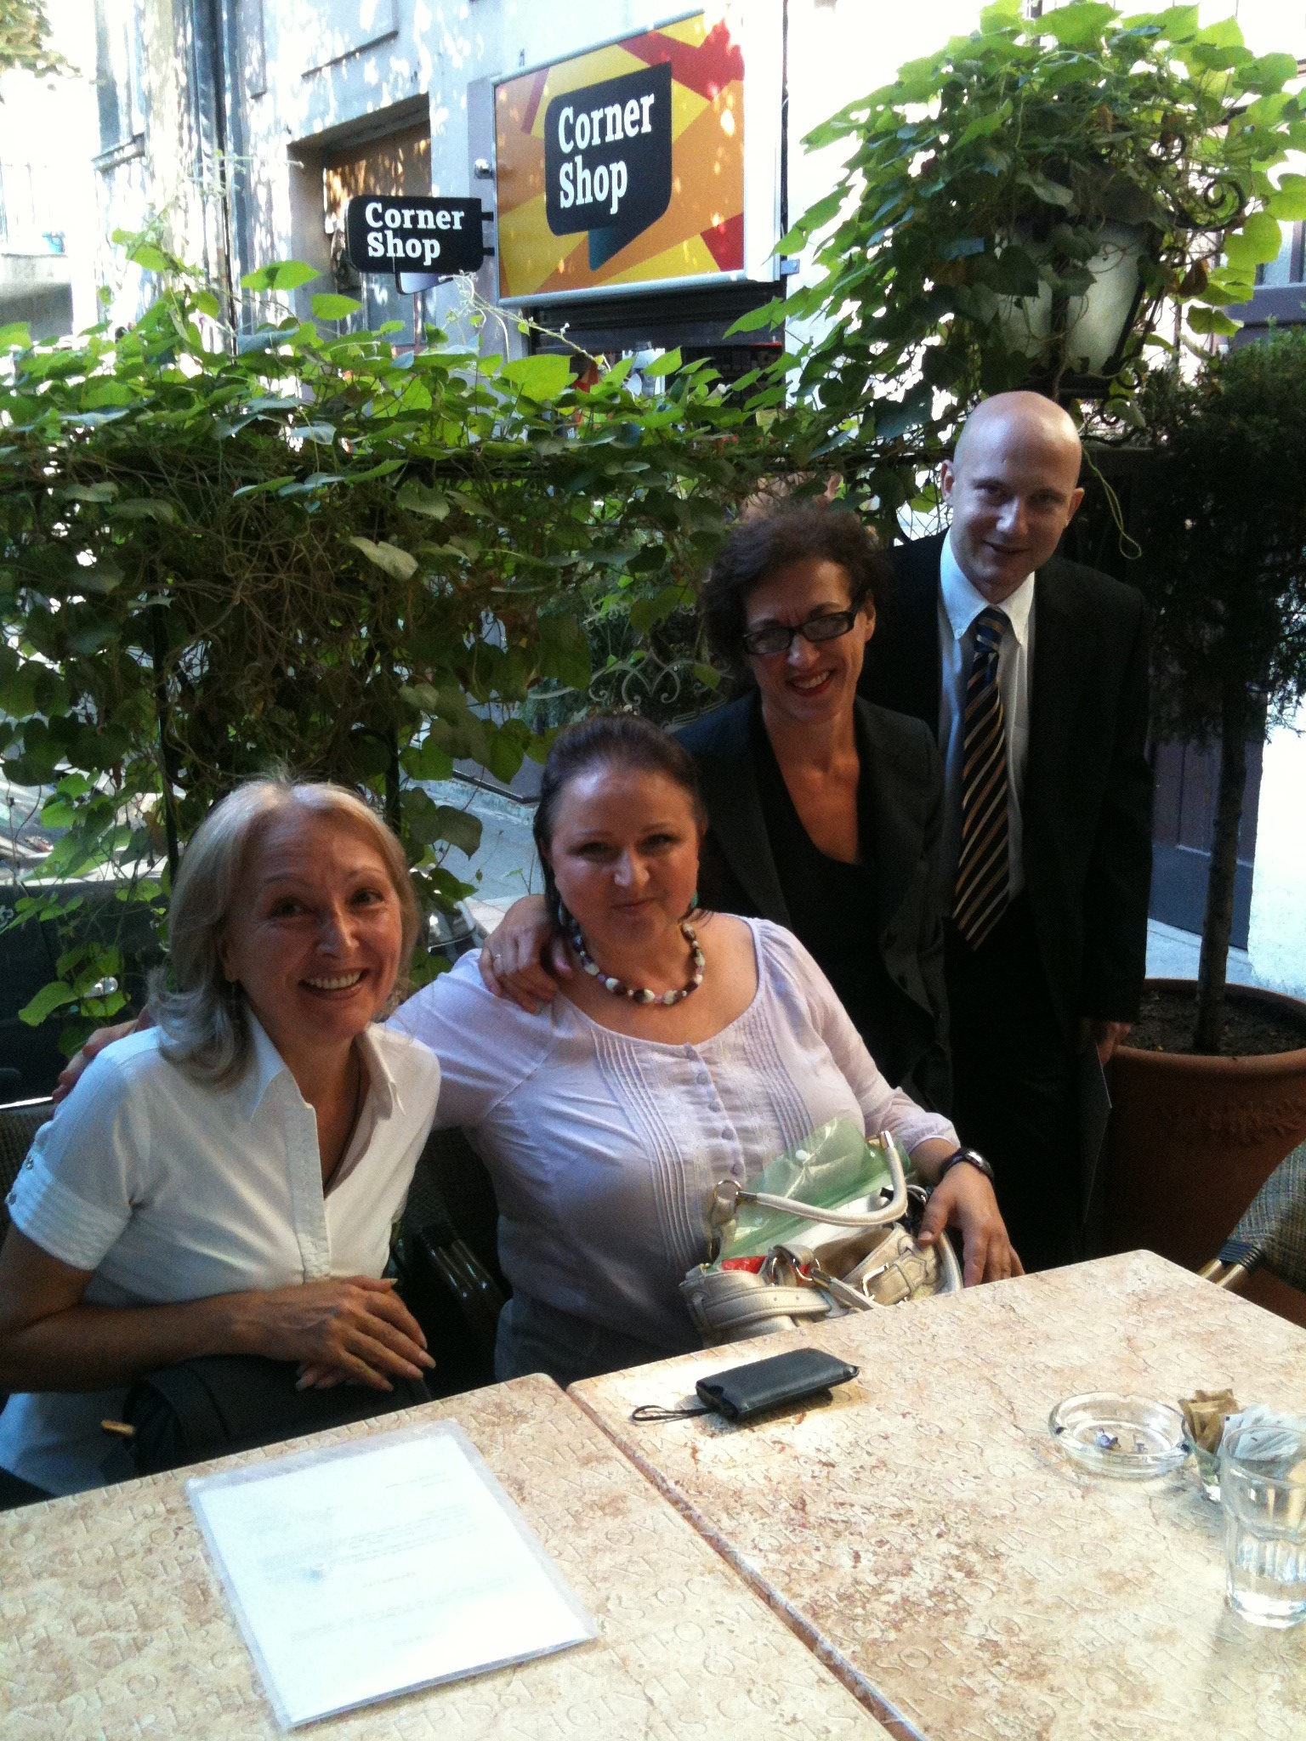
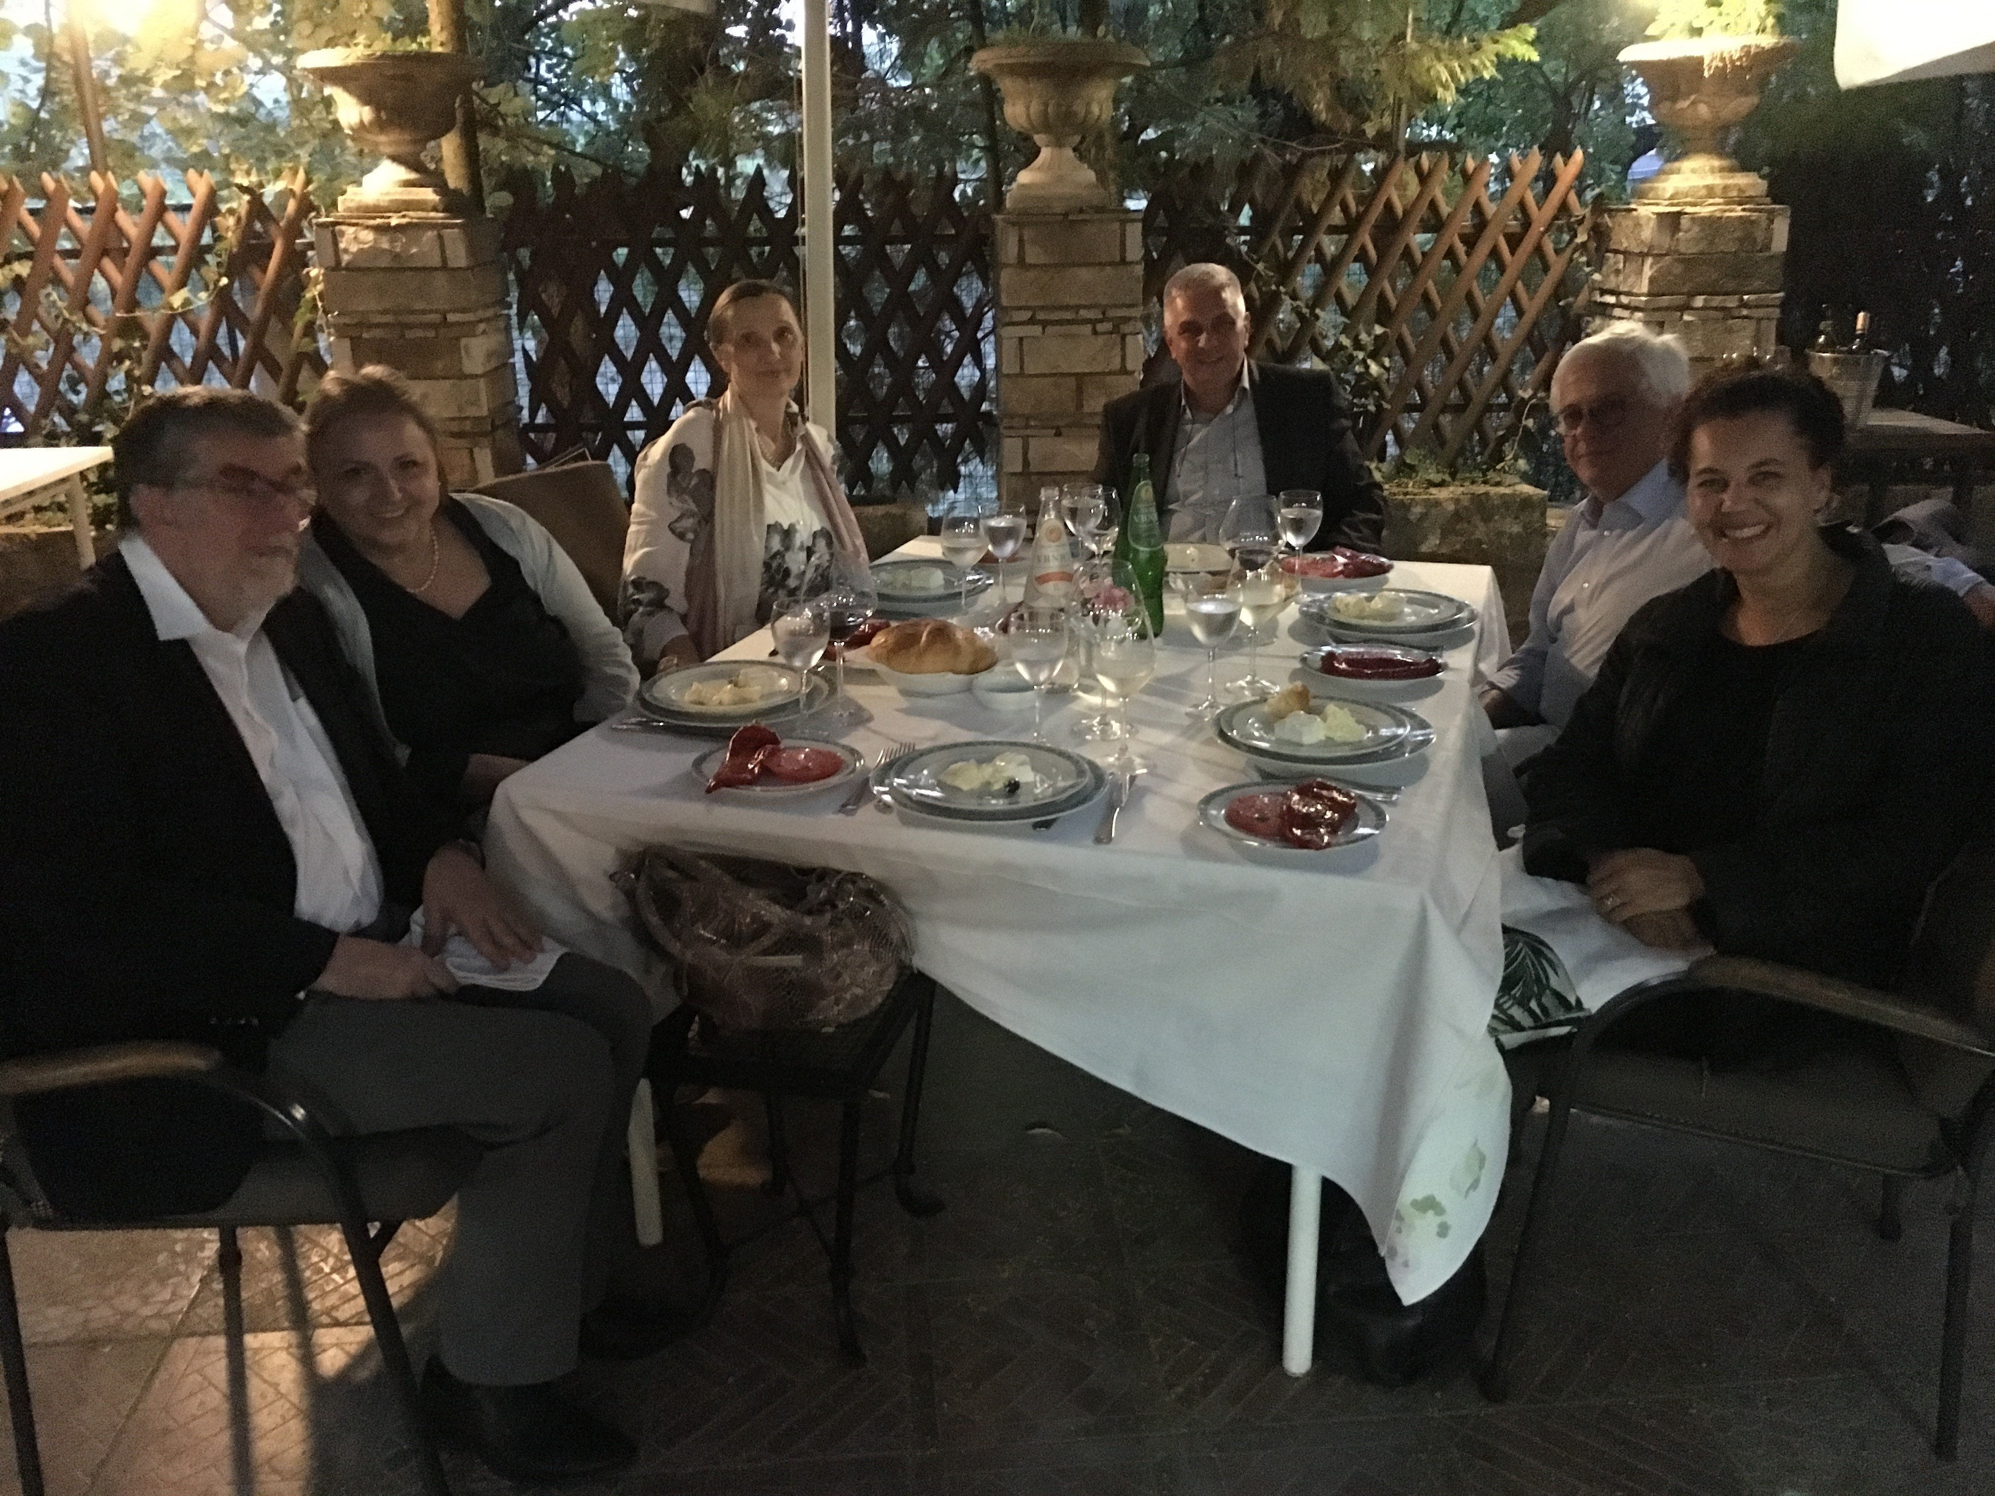
2018
2011

Slide 5
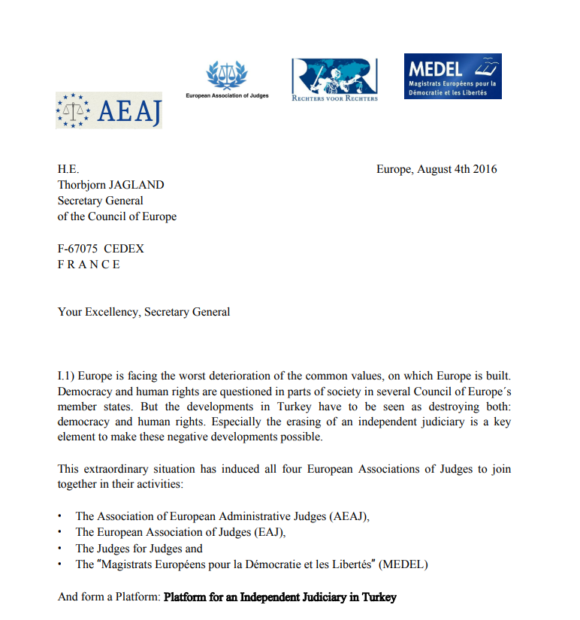
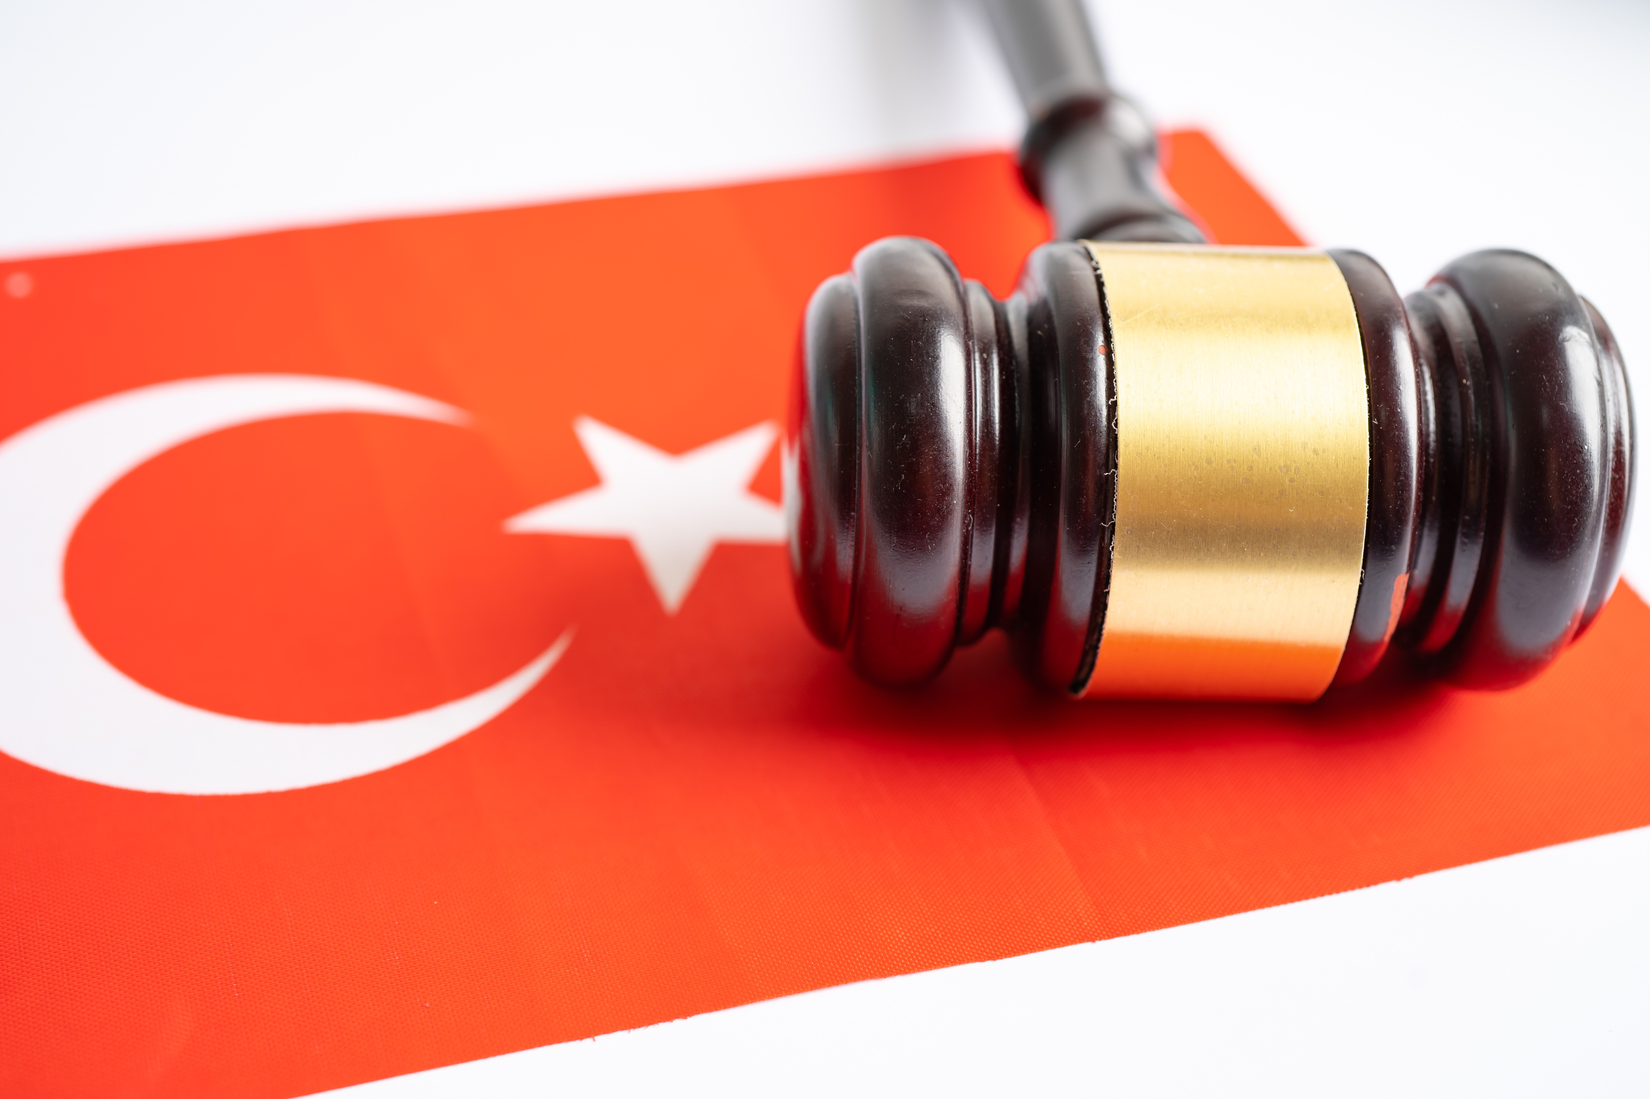
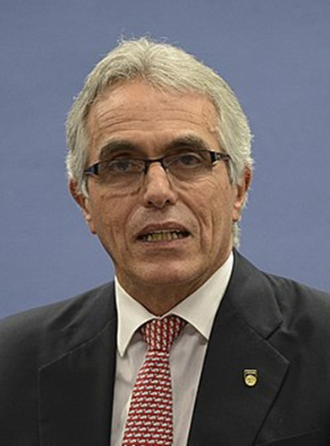
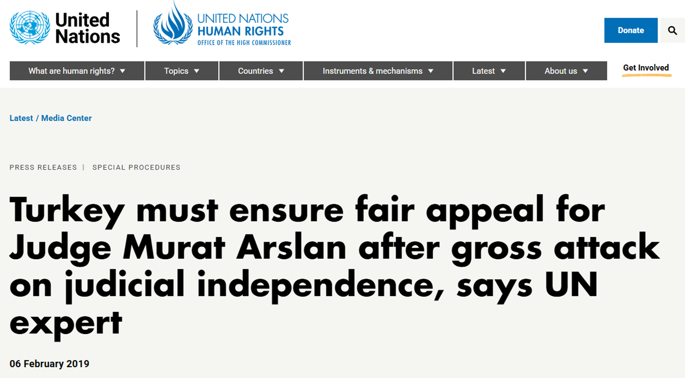

Slide 6
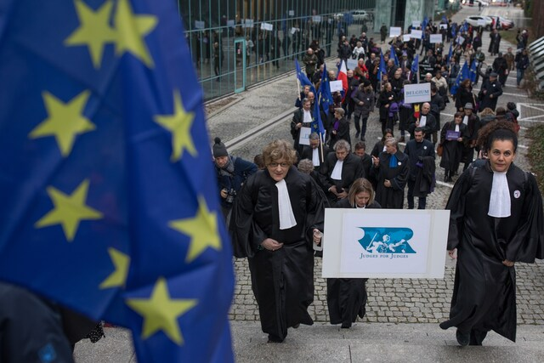
Four European organisations of judges are appealing to the European Court of Justice against the first instance order refusing them standing to challenge the Council’s approval of the Polish Recovery and Resilience Plan.

Slide 8
Congratulations on your anniversary
&
Let’s keep walking the path together!

